Slide 1

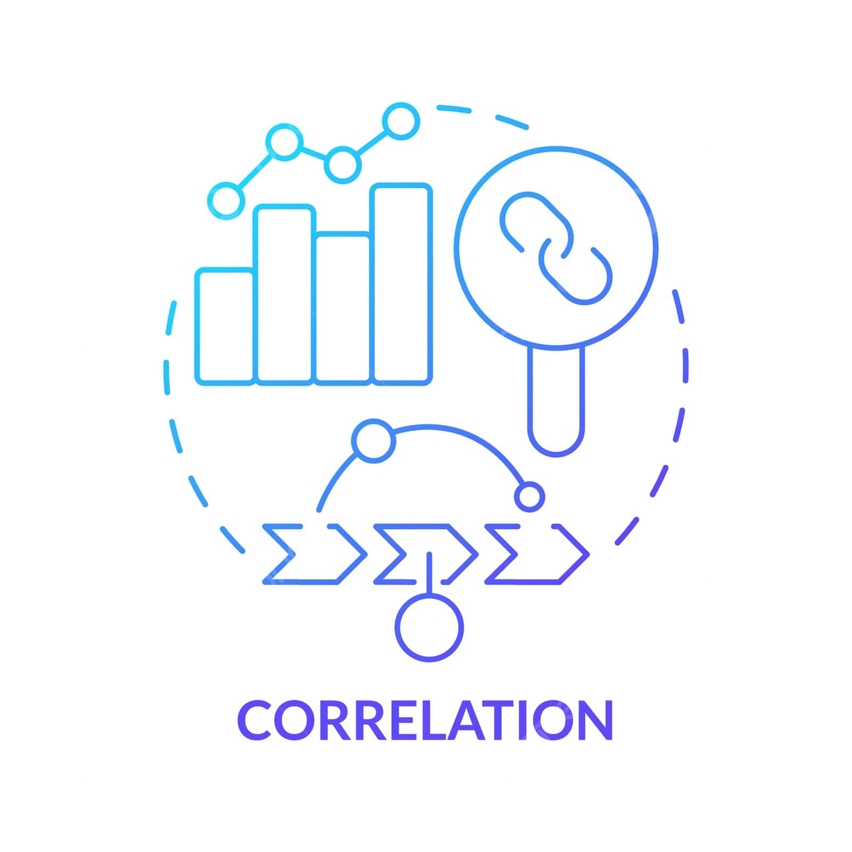

Correlation analysis
(simple , partial and multiple)

Slide 2
Correlation analysis
Correlation analysis is a statistical method used to quantify the strength and the direction of the linear relationship between two or more variables.
Correlation analysis is used to determine if and how strongly variables are related . It helps in predicting modelling, decision making and hypotheses testing.
Simple correlation
Simple correlation is a statistical method used for determining the strength and direction of the linear relationship between two variables.
Examples:
Yield of paddy and the use of fertilizers
A student’s class attendance and their test scores
Exercise and weight loss
Screen Time vs. Academic Performance

Slide 3
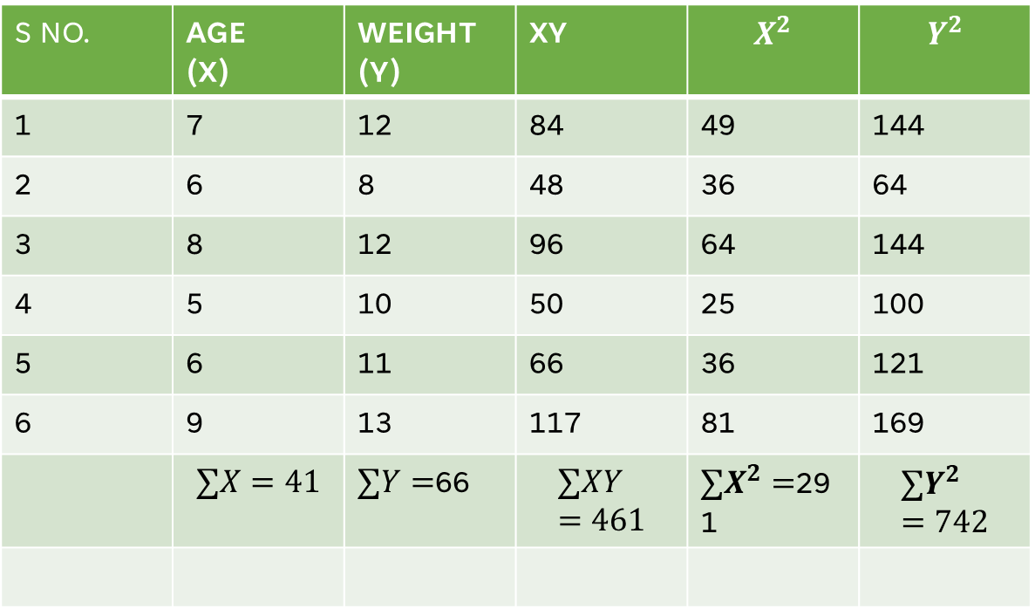
A sample of 6 children was selected, data about their age in weeks and weight in kilograms was recorded as shown in the following table . It is required to find the correlation between age and weight.
S NO. | AGE (X) | WEIGHT (Y) | XY | $$X^{2}$$ | $$Y^{2}$$
1 | 7 | 12 | 84 | 49 | 144
2 | 6 | 8 | 48 | 36 | 64
3 | 8 | 12 | 96 | 64 | 144
4 | 5 | 10 | 50 | 25 | 100
5 | 6 | 11 | 66 | 36 | 121
6 | 9 | 13 | 117 | 81 | 169
 | $$∑X=41$$ | $∑Y=$66 | $$∑XY=461$$ | $∑X^{2}=$291 | $$∑Y^{2}=742$$
r=0.76
That means strong positive correlation between Age and Weight.

Slide 4
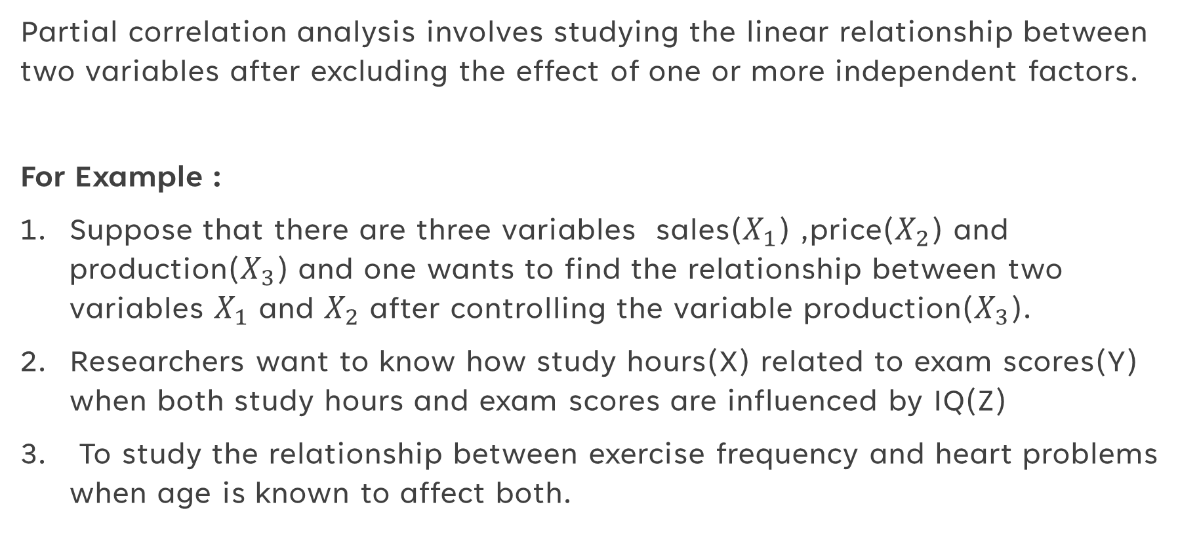
Partial correlation
Partial correlation analysis involves studying the linear relationship between two variables after excluding the effect of one or more independent factors.
For Example :
Suppose that there are three variables sales($X_{1}$) ,price($X_{2}$) and production($X_{3}$) and one wants to find the relationship between two variables $X_{1}$ and $X_{2}$ after controlling the variable production($X_{3}$).
Researchers want to know how study hours(X) related to exam scores(Y) when both study hours and exam scores are influenced by IQ(Z)
To study the relationship between exercise frequency and heart problems when age is known to affect both.

Slide 5
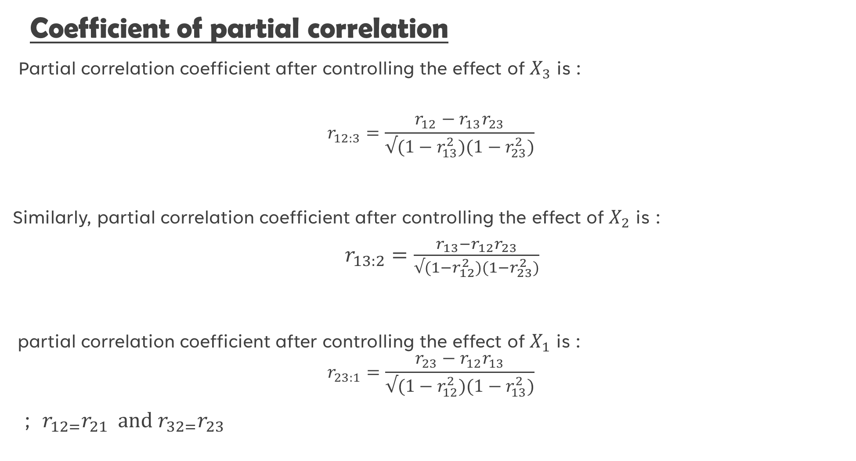
Coefficient of partial correlation
Partial correlation coefficient after controlling the effect of $X_{3}$ is :
$$r_{12:3}=\frac{r_{12}−r_{13}r_{23}}{√(1−r_{13}^{2})(1−r_{23}^{2})}$$
Similarly, partial correlation coefficient after controlling the effect of $X_{2}$ is :
$r_{13:2}=\frac{r_{13}−r_{12}r_{23}}{√(1−r_{12}^{2})(1−r_{23}^{2})}$
partial correlation coefficient after controlling the effect of $X_{1}$ is :
$$r_{23:1}=\frac{r_{23}−r_{12}r_{13}}{√(1−r_{12}^{2})(1−r_{13}^{2})}$$
; $r_{12=}r_{21}$ and $r_{32=}r_{23}$

Slide 6
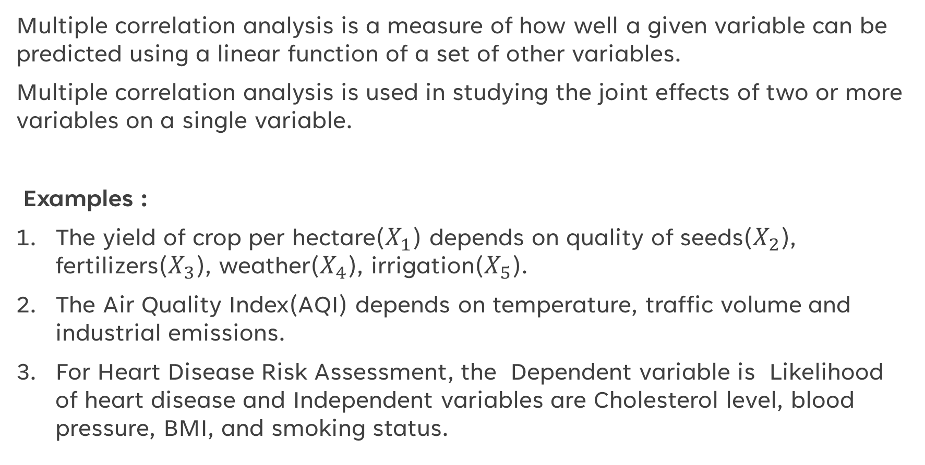
multiple correlation
Multiple correlation analysis is a measure of how well a given variable can be predicted using a linear function of a set of other variables.
Multiple correlation analysis is used in studying the joint effects of two or more variables on a single variable.
Examples :
The yield of crop per hectare($X_{1}$) depends on quality of seeds($X_{2}$), fertilizers($X_{3}$), weather($X_{4}$), irrigation($X_{5}$).
The Air Quality Index(AQI) depends on temperature, traffic volume and industrial emissions.
For Heart Disease Risk Assessment, the Dependent variable is Likelihood of heart disease and Independent variables are Cholesterol level, blood pressure, BMI, and smoking status.

Slide 7
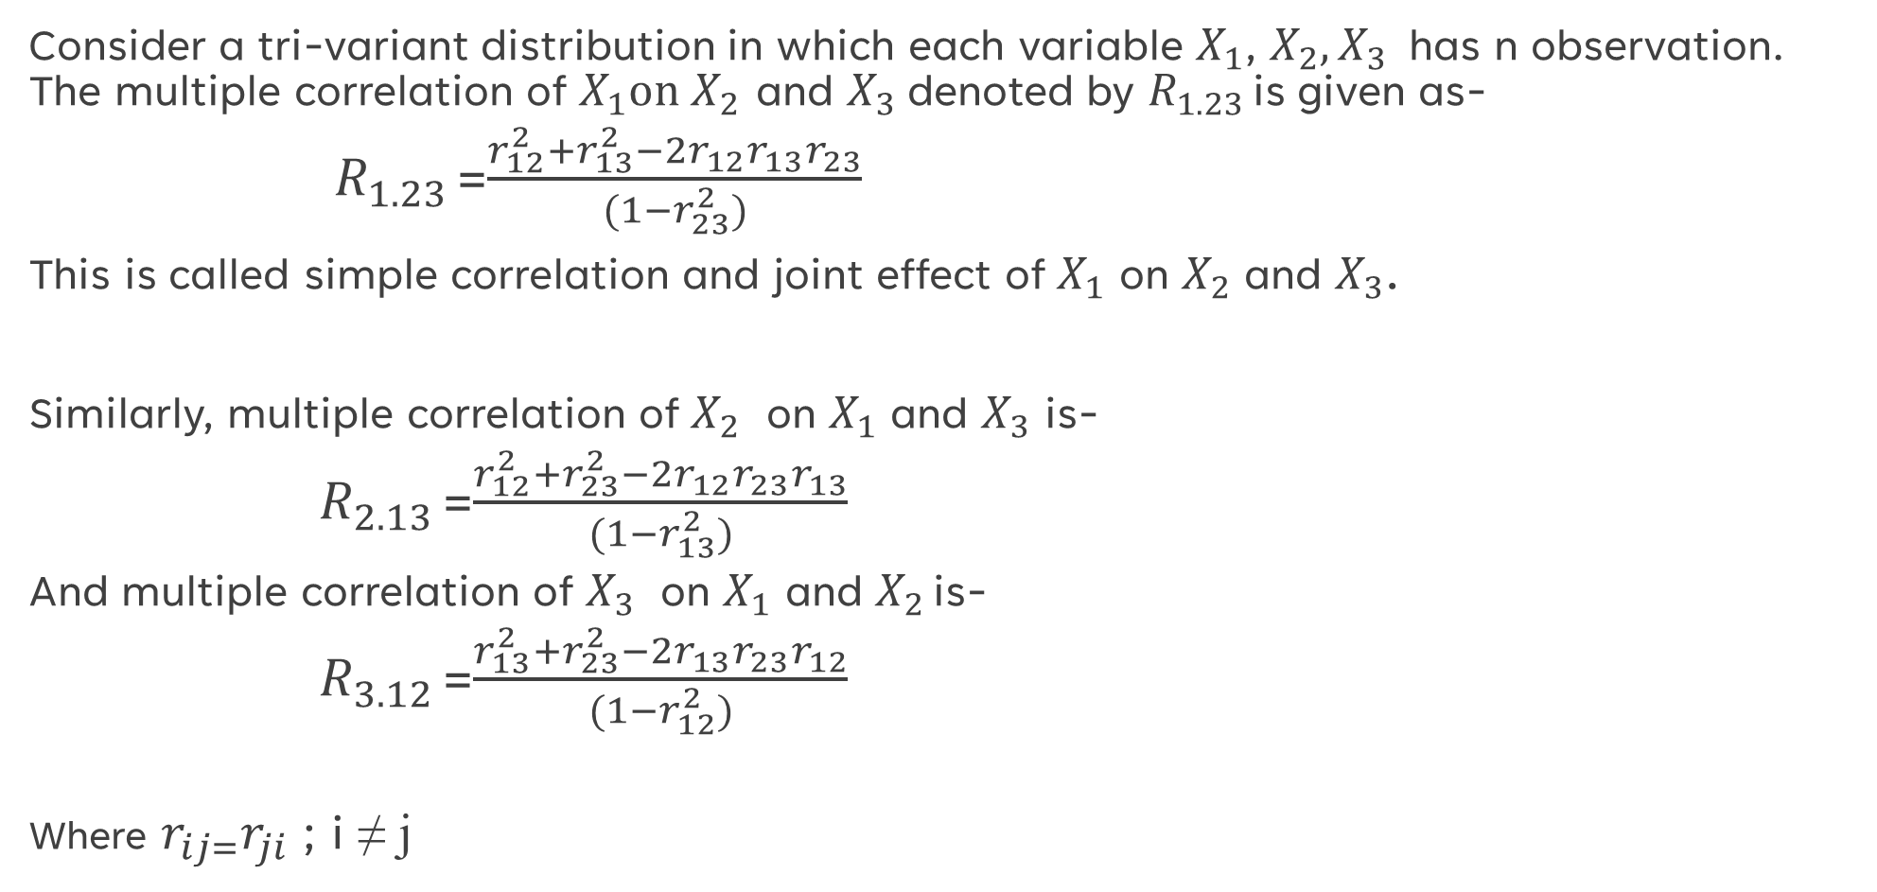
Coefficient of multiple correlation
Consider a tri-variant distribution in which each variable $X_{1}$, $X_{2},X_{3}$has n observation. The multiple correlation of $X_{1}on X_{2 }$and $X_{3}$denoted by $R_{1.23 }$is given as-
$R_{1.23 }$=$\frac{r_{12}^{2}+r_{13}^{2}−2r_{12}r_{13}r_{23}}{(1−r_{23}^{2})}$
This is called simple correlation and joint effect of $X_{1}$ on $X_{2}$ and $X_{3}$.
Similarly, multiple correlation of $X_{2}$ on $X_{1}$ and $X_{3}$ is-
$R_{2.13 }$=$\frac{r_{12}^{2}+r_{23}^{2}−2r_{12}r_{23}r_{13}}{(1−r_{13}^{2})}$
And multiple correlation of $X_{3}$ on $X_{1}$ and $X_{2 }$is-
$R_{3.12 }$=$\frac{r_{13}^{2}+r_{23}^{2}−2r_{13}r_{23}r_{12}}{(1−r_{12}^{2})}$
Where $r_{ij=}r_{ji}$ ; i ≠ j

Slide 8
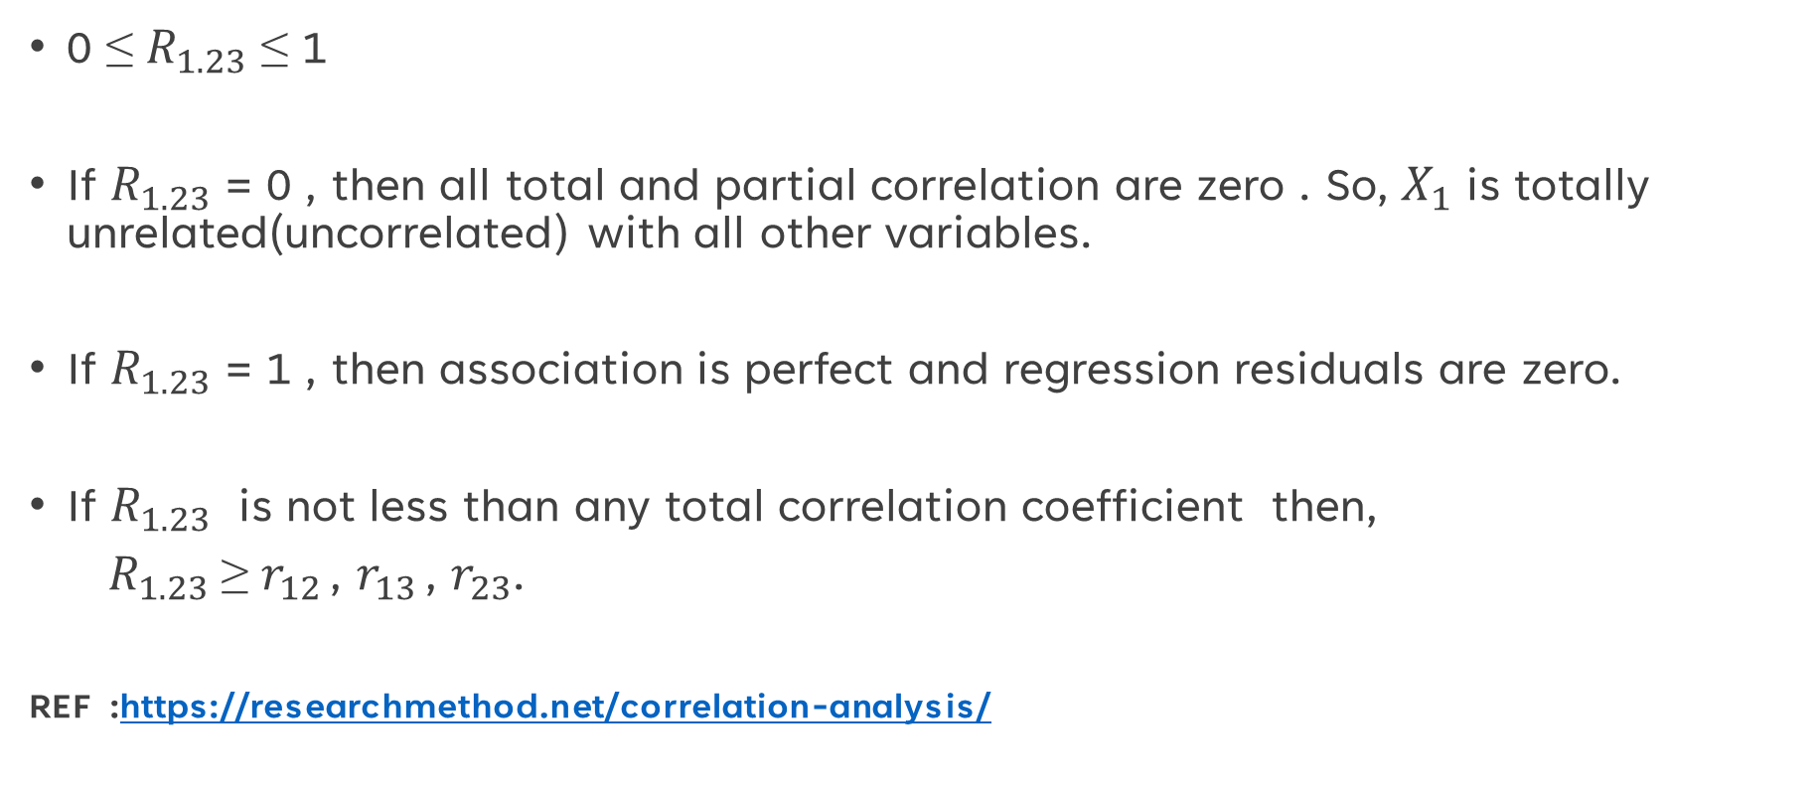
Properties of multiple correlation coefficient
0 ≤ $R_{1.23}$ ≤ 1
If $R_{1.23}$ = 0 , then all total and partial correlation are zero . So, $X_{1}$ is totally unrelated(uncorrelated) with all other variables.
If $R_{1.23}$ = 1 , then association is perfect and regression residuals are zero.
If $R_{1.23}$ is not less than any total correlation coefficient then,
$R_{1.23}$≥ $r_{12 }$, $r_{13 }$, $r_{23}$.
REF :https://researchmethod.net/correlation-analysis/

Slide 9
THANK YOU

